Slide 1
Test Process - IBM Rational Synergy and Change

Slide 2
Test Process
Testing is a Process rather than a single activity. This process starts from test planning, designing test cases, preparing test execution and exit criteria.
Basic steps involved are :
Test Planning
Test Analysis and Design
Implementation and Execution
Evaluating exit criteria

Slide 3
Test Process – Synergy and Change
Test Planning
Test analysis and Test Design
Test implementation and execution
Defect Management
Exit criteria

Slide 4
Test Planning
Test Planning is done to identify scope of testing
ccm_sqe database is used for Test Plan preparation
Determine the required test resources, PCs, environments
Exit Criteria

Slide 5
Test Analysis and Design
Analysing the requirements and purpose for Testing
Design the test cases as per the requirements

Slide 6
Test Implementation and Execution
Creation of Test Plan to include all the test cases and the CRs involved as part of the release
Installing and updating the Synergy and Change run areas with the latest build on all the platforms (Windows, RHEL, Solaris and Aix)
Test automation – currently used for regression testing
Execution of Test Cases and CR validation

Slide 7
Defect Management
Retesting the CRs as part of that release
ccm_review database is used as a repository for internal and external CRs
Creating New Defects
Defect Closure

Slide 8
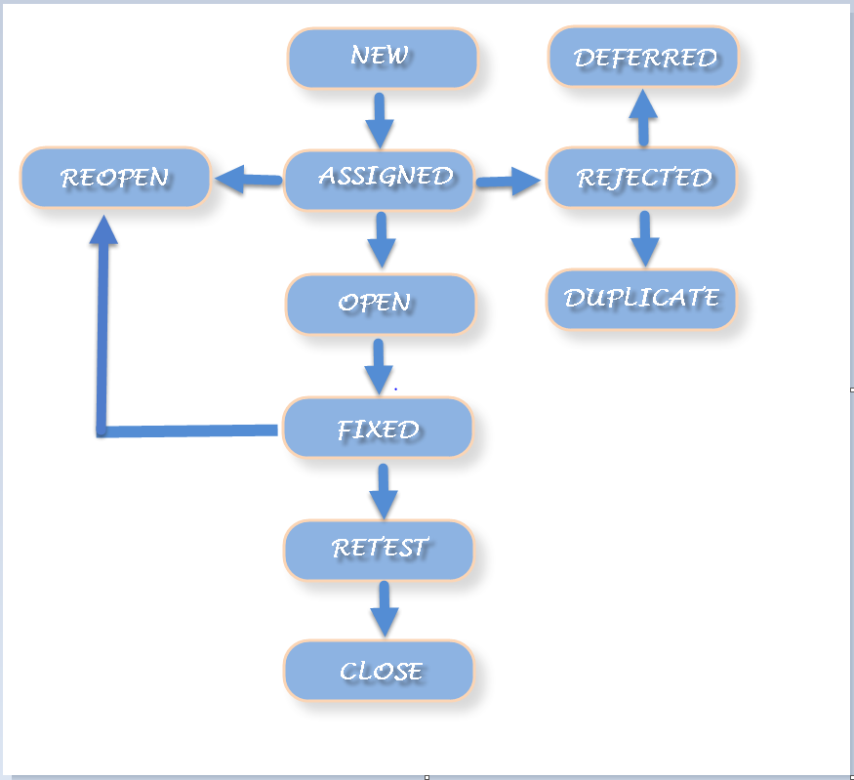
Defect Life Cycle

Slide 9
Exit Criteria
Successfull installation of the latest build for Synergy and Change on all platforms
All the CRs in the patch object are verified in the ccm_review database for a release
Successful execution of all the test cases as part of the release in ccm_sqe database

